Slide 1
Exam Power Bi
MentorShip Program

Slide 2
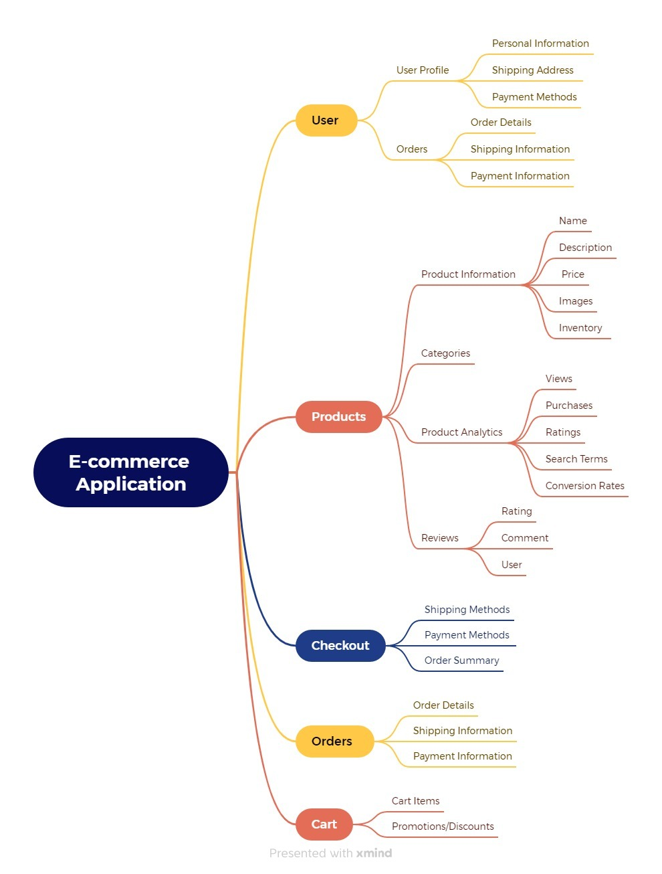
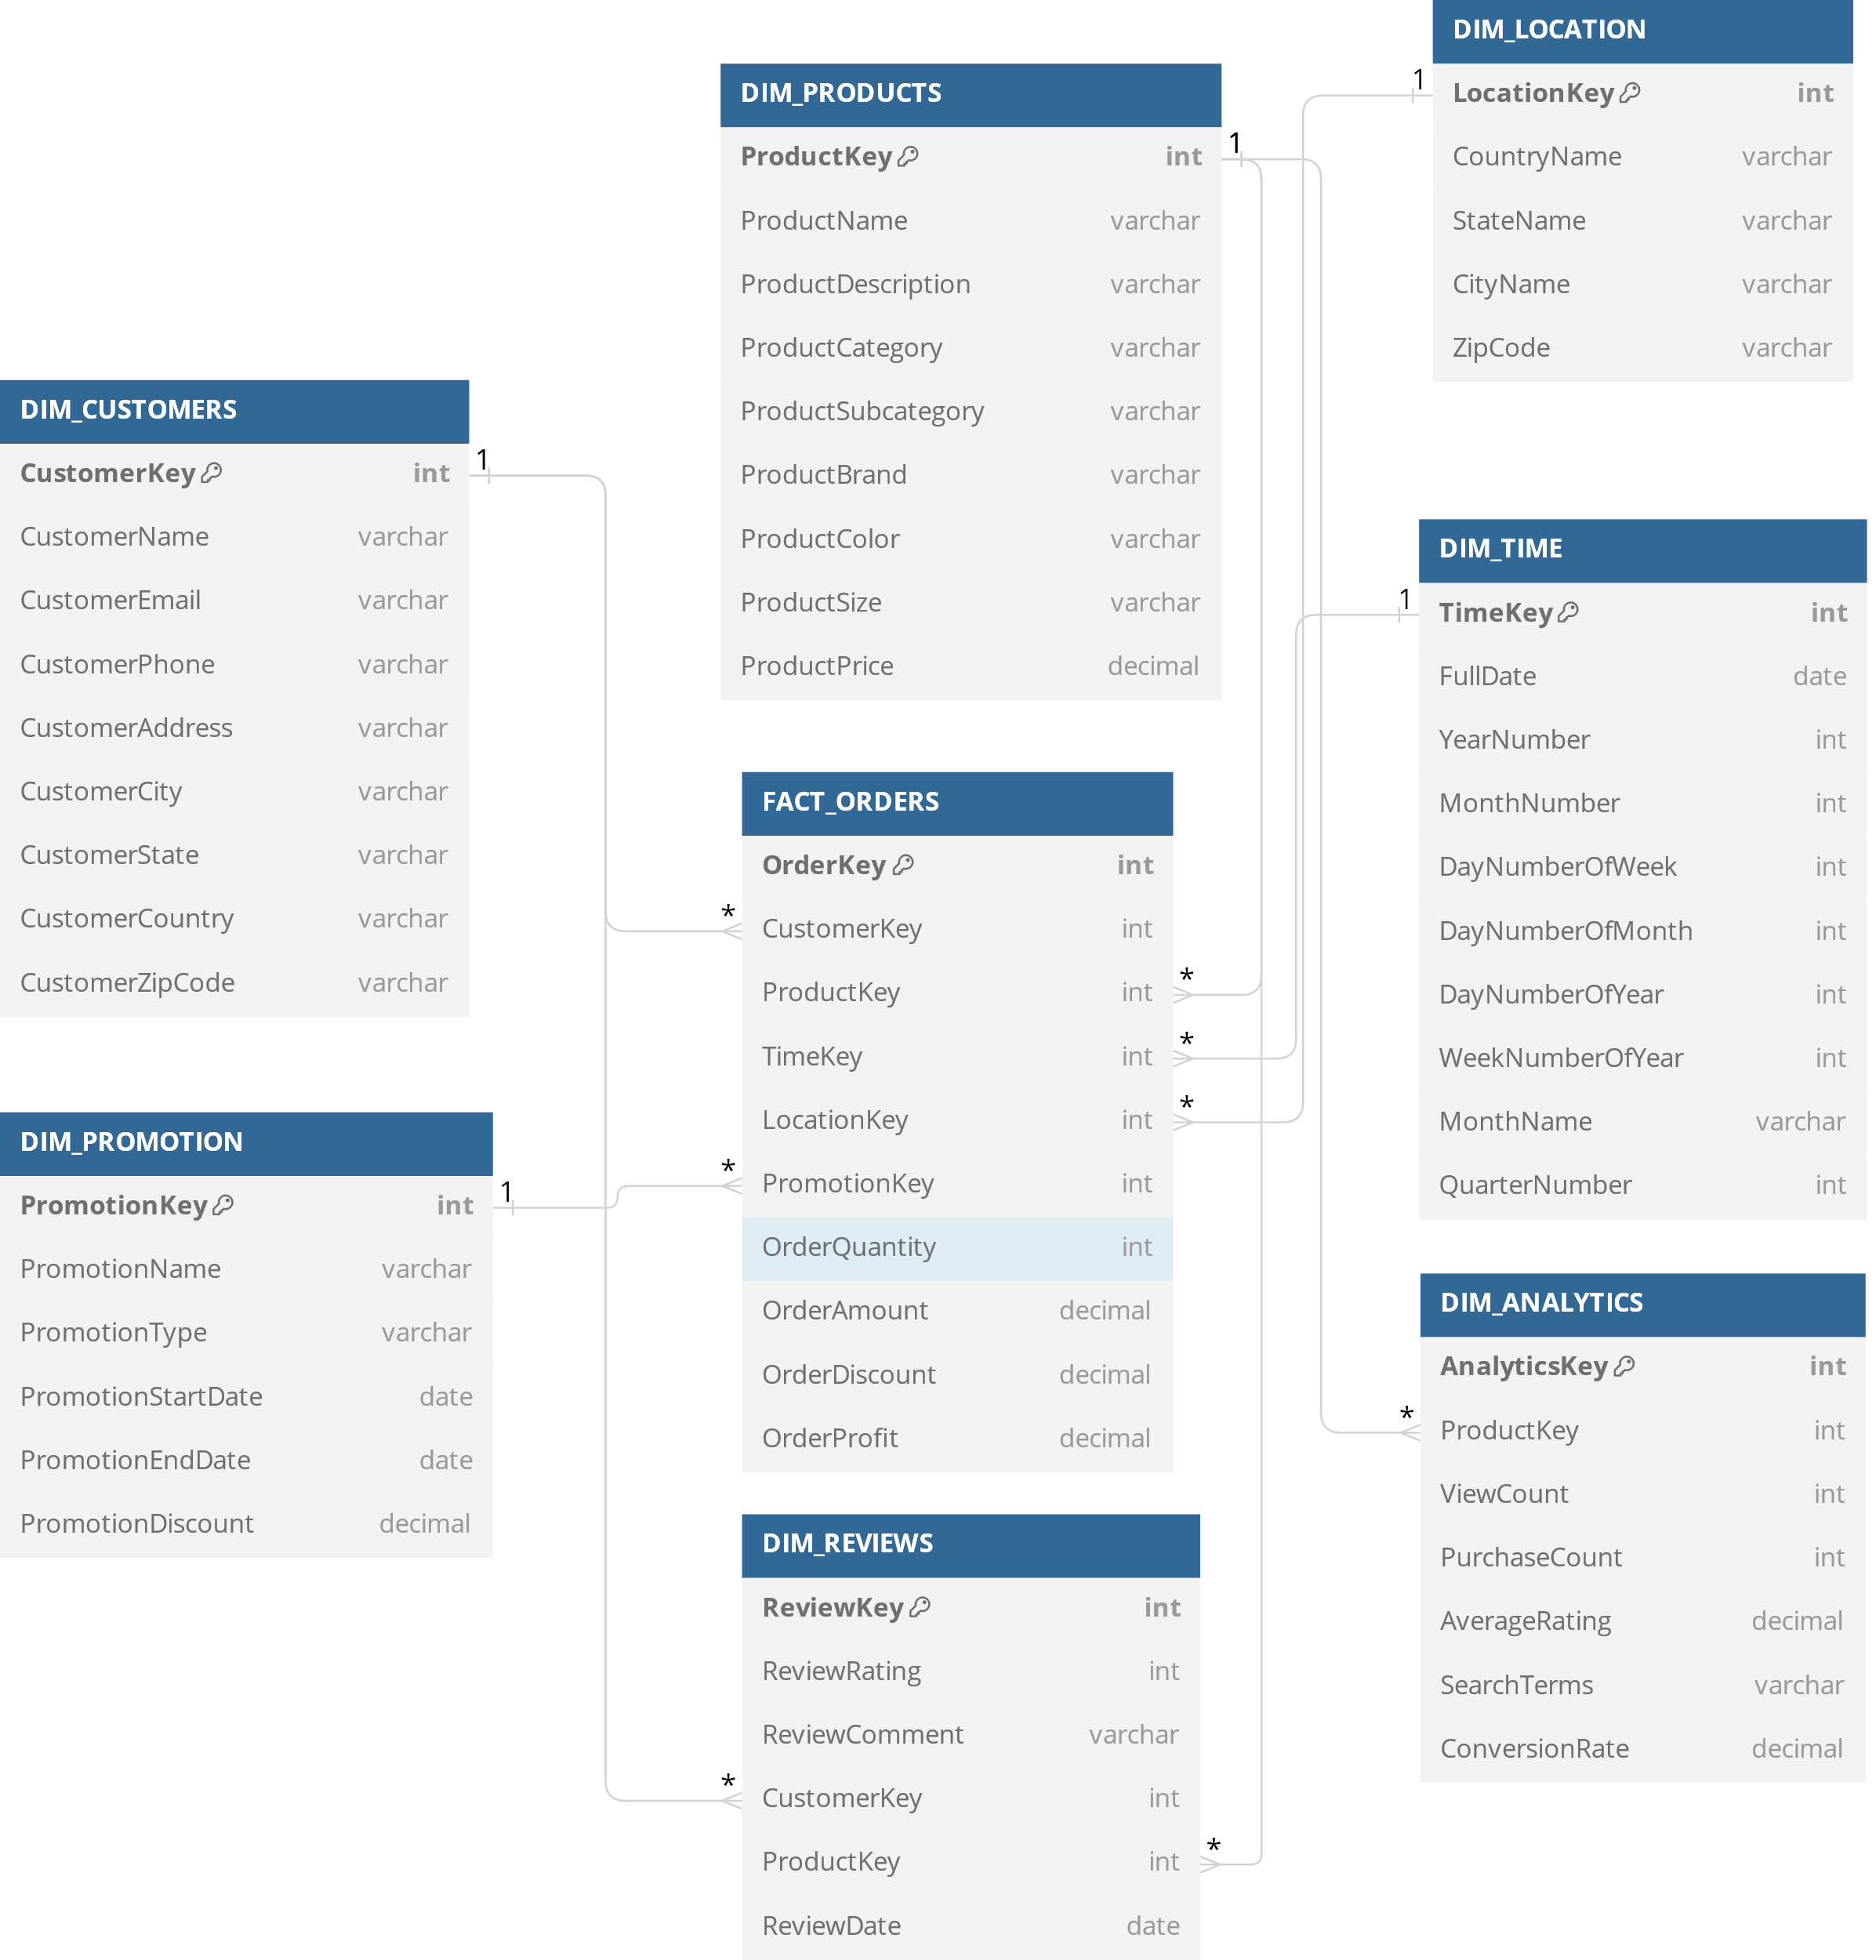

Slide 3
